Slide 1


IP Capitalization Handbook
© Pintas IP Group 2022

Slide 2


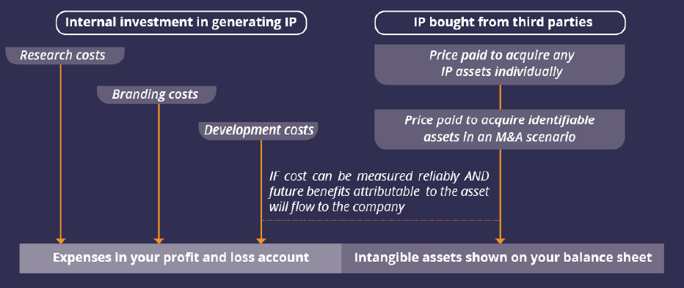

Slide 3
4-Step Capitalize IP Assets
4. Transfer IP To Capitalize IP Assets to IP Holding Co
1. Create IP Assets
Initiate the IP creation
Ensure Full compliance with corporate, accounting & tax rules
04
01
03
02
2. Establish an IP Holding Co
3. Evaluate Your IP Assets
Set up an IP Holding Co in a IP friendly jurisdiction
With a valuation method suitable to your business

Slide 4
4-Step To Capitalize IP Assets
1. Create IP Assets
Initiate the IP creation
IP Assets initiatlly reside outside of the operating co.
IP Assets can initially be owned by the founder
04
01
03
02

Slide 5
4-Step To Capitalize IP Assets
04
01
2. Establish an IP Holding Co
Establish an IP Holding Co
Preferably establish in an IP friendly jurisdiction
IP Holding can apply for tax incentives under the modified IP Nexus Scheme.
03
02

Slide 6
4-Step To Capitalize IP Assets
04
01
3. Evaluate Your IP Assets
Apply a valuation method suitable to your Business
Valuation Methodology: Cost, Market or Economics Basis
03
02

Slide 7
4-Step To Capitalize IP Assets
4. Transfer To IP Assets to IP Holding Co
Based on the valuation report, the IP Assets will be capitalized in the IP Holding Co.
Full compliance with corporate, accounting & tax rules
IP Holding to collect royalties from operating co
04
01
03
02

Slide 8

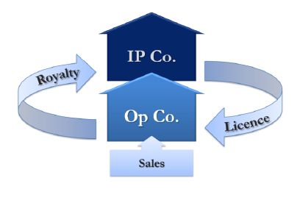

Optimum IP Structure

Slide 9
Cost Benefit Analysis
Benefits of an IP Capitalisation
Recognition of the value of the IP assets within the balance sheet of IP Co.
Demonstration of the future off-balance sheet value based on the flow of royalties attached to the IP assets.
Income Tax Saving Through Modified IP Nexus Status.
Protection of IP assets against the risk of bank/ creditor/ competitor threat/ Succession Planning.

Slide 10

Our Contact
Malaysia Office T: +603-78765050 E: pintas.my@pintas-ip.com | Singapore Office T:+65 62502070 E: pintas.sg@pintas-ip.com
USA Representative Office T: +1 208 899 8528 E: pintas.us@pintas-ip.com | China Representative Office T: +86 21 68877080 E: pintas.china@pintas-ip.com
URL: www.pintas-ip.com

